Slide 1
Symbol Recognition using Average Images
Devin Smith
Christine Alvarado
Sarah Harris
July 26, 2007
Notes:
Welcome.

Slide 2
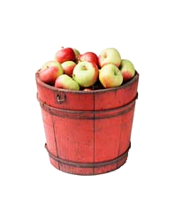
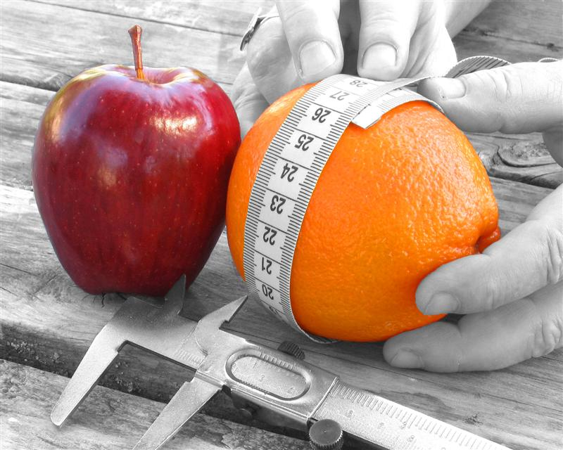
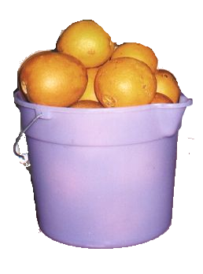
What is classification?
Problem: Label items based on their properties.
Notes:
First of all, what is classification? Classification is the act of labeling an item. For example, assume we are given a bunch of apples and oranges label. Using properties inherent within apples and oranges, such as color, weight, volume, diameter, etc, we can determine which ones are apples and which ones are oranges.

Slide 3
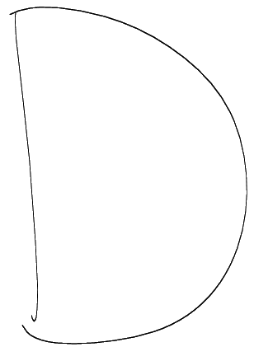
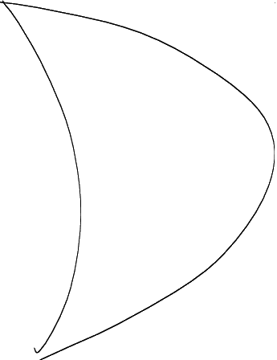
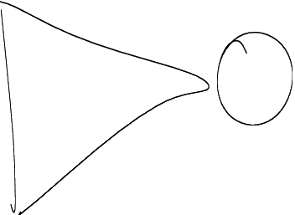
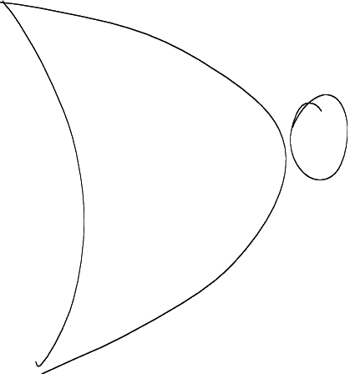
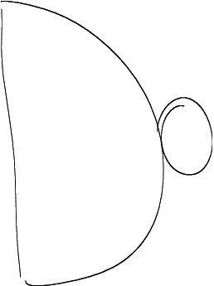
Sketched Digital Logic Symbols
And
Or
Not
Nor
Nand
Notes:
Here is the domain that we have focused on. The symbols are well defined, although certain symbols may look alike in some cases.

Slide 4
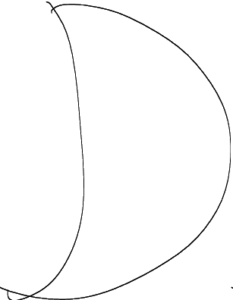
Goal!
Develop a general symbol recognizer.
We want:
Symbol | And | Or | Not | Nor | Nand
Probability | 0.20 | 0.73 | 0.01 | 0.05 | 0.01
Notes:
For example, given the following symbol, we would like the symbol recognizer to return something like the given table.

Slide 5
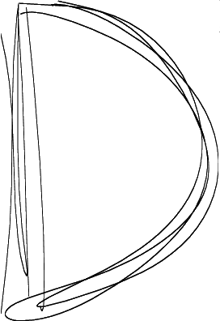
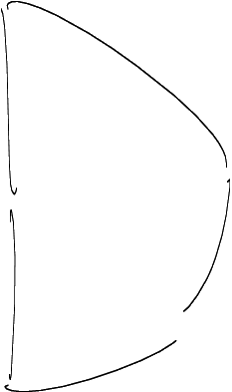
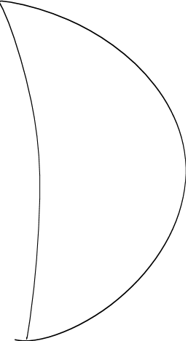
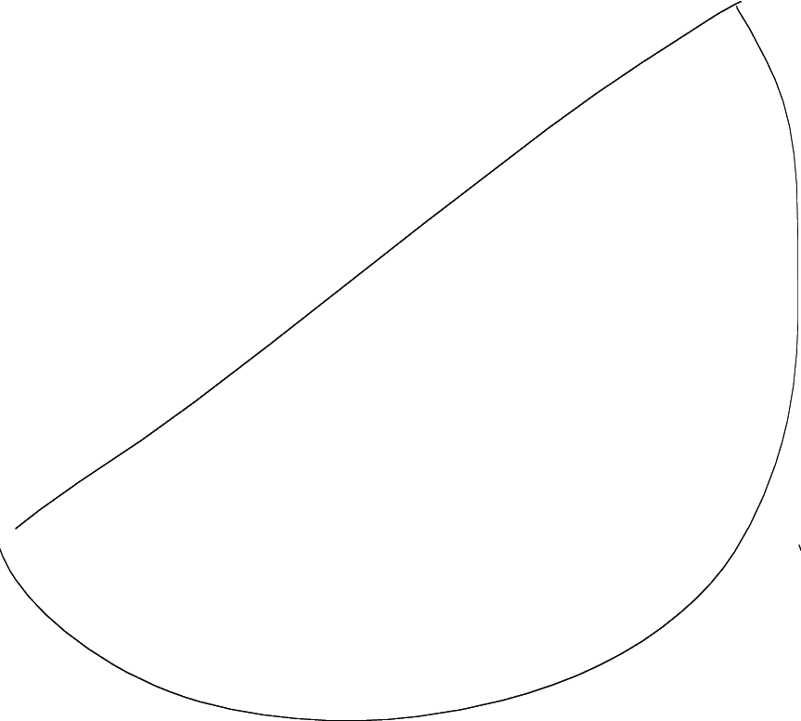
Problems with Symbols
Overstroked
Understroked
Rotated
Ambiguous
Notes:
Overstroked symbol where the user repeatedly draws over a region.
Understorked symbol where the outline of the symbol is present, but the strokes are not connected.
Rotated symbol where the symbol is not drawn in line with the common direction.
Ambiguous symbol, where humans would not even be able to tell the difference.
WORK ON WHY FEATURE / STROKE BASED DOESN’T WORK

Slide 6

Simplify the Data!
Raw sketch data is a bunch of (x, y, t) points. Working with this presents many challenges.
One way to approach symbol recognition is to transform the data into a visual problem.
Notes:
Raw sketch data bunch of (x y t). Working presents challenges, such as extracting useful information.

Slide 7

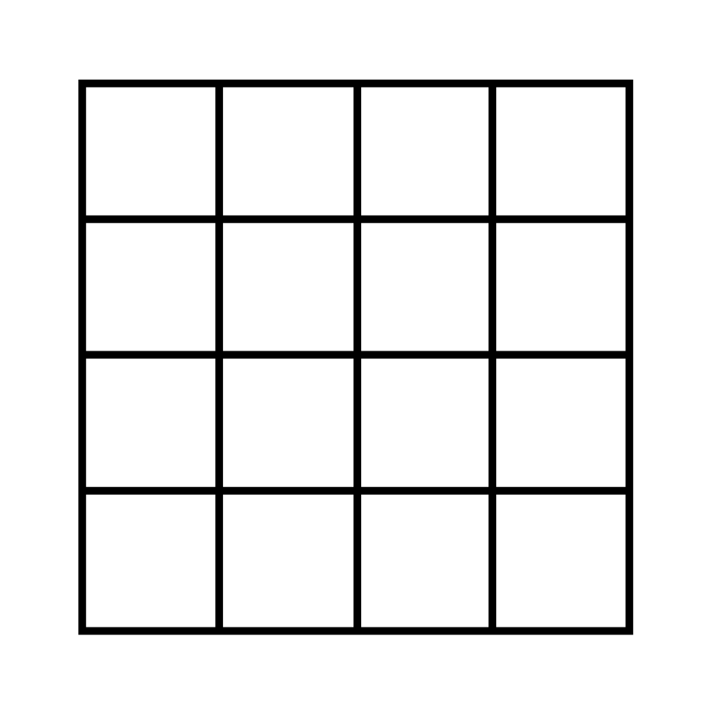
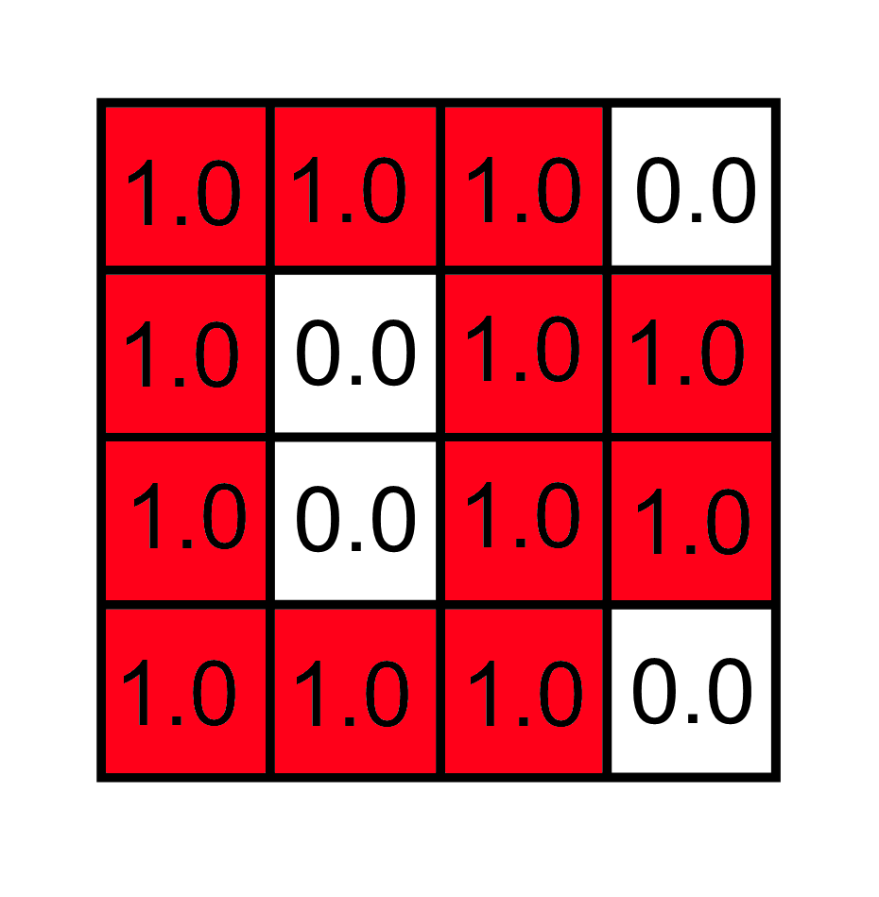
Symbol to Image
Notes:
First, we take a sketched symbol and place it over a matrix.
Next, we find all of the cells where ink is present.
If ink is present, the value of the cell is 1.0.
Otherwise, the value is 0.0.
(Next slide motivation for distance transform: aka comparing two images.)
Red = 1.0 consistent, white = 0.0 consistent

Slide 8
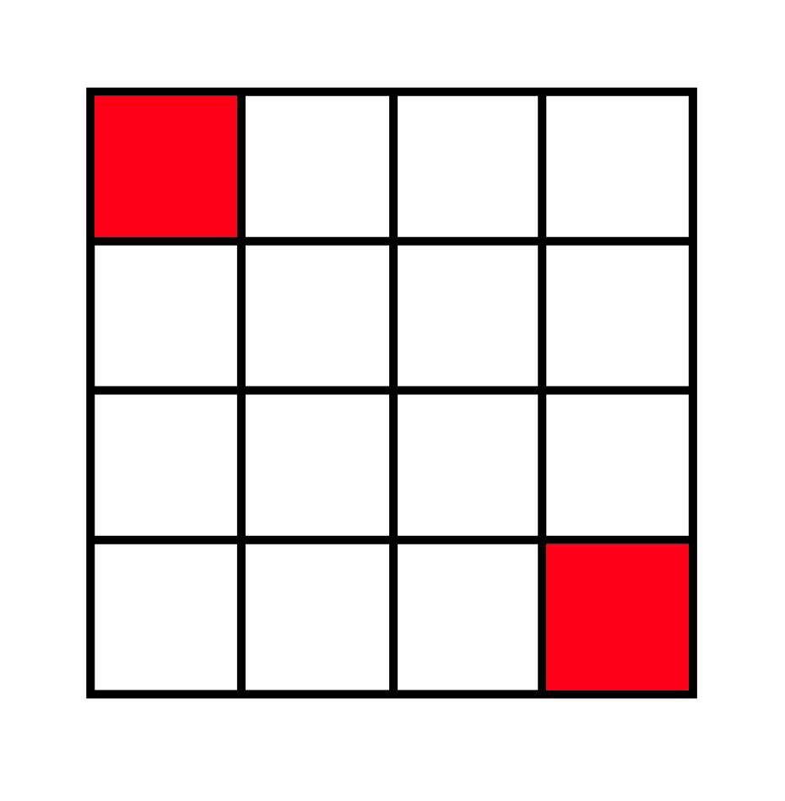
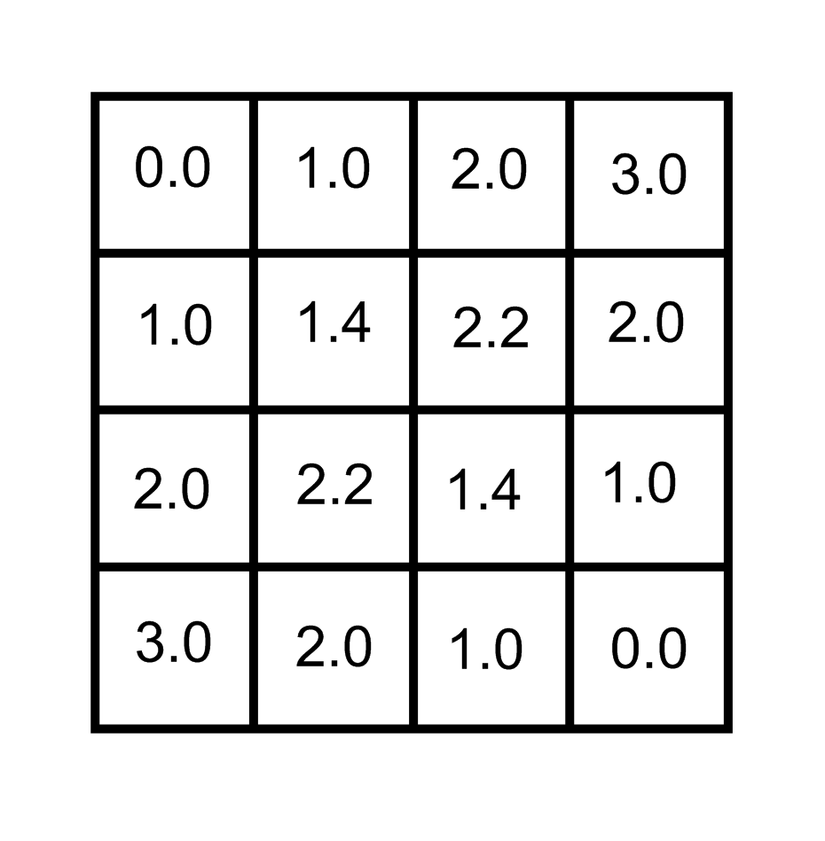
Image to Distance Transform
Image
Distance Transform
Notes:
Motivate this by saying that we need to compare this image to other images.
Remember red = 1, white = 0
Make animation?
How does transform help us? (introduce later?) move to after first hausdorff example ||a – b||

Slide 9

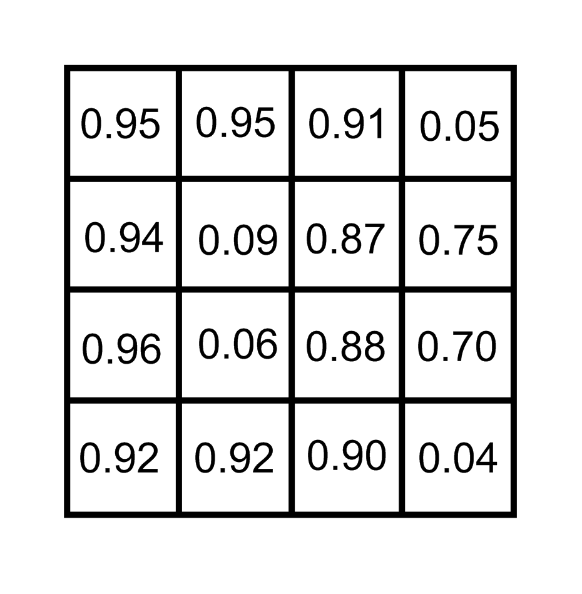

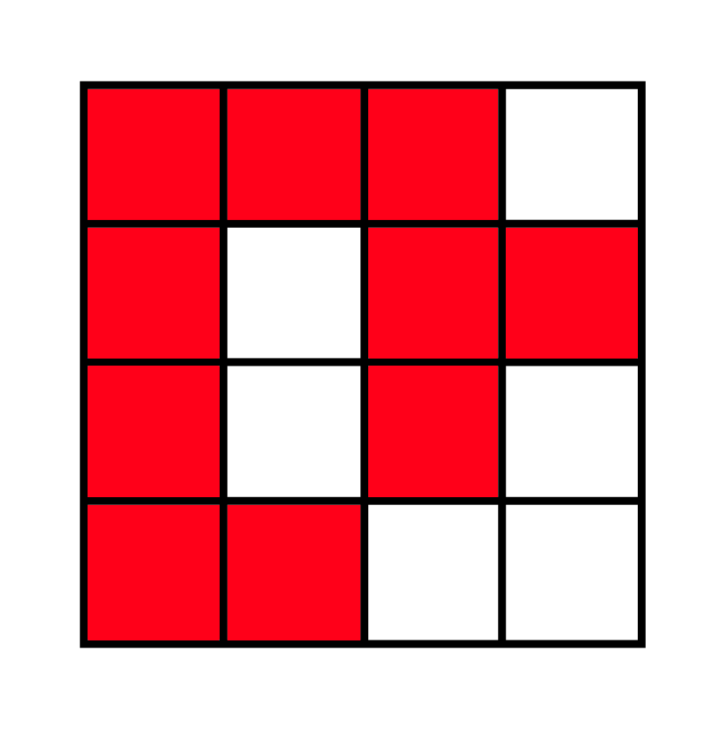

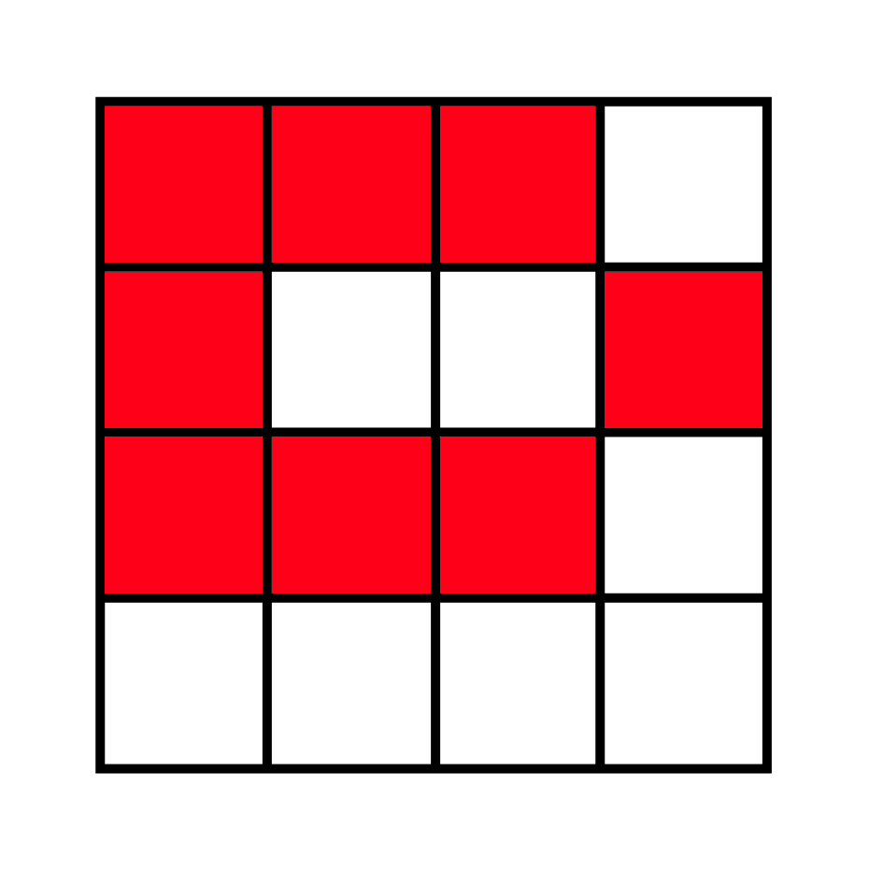

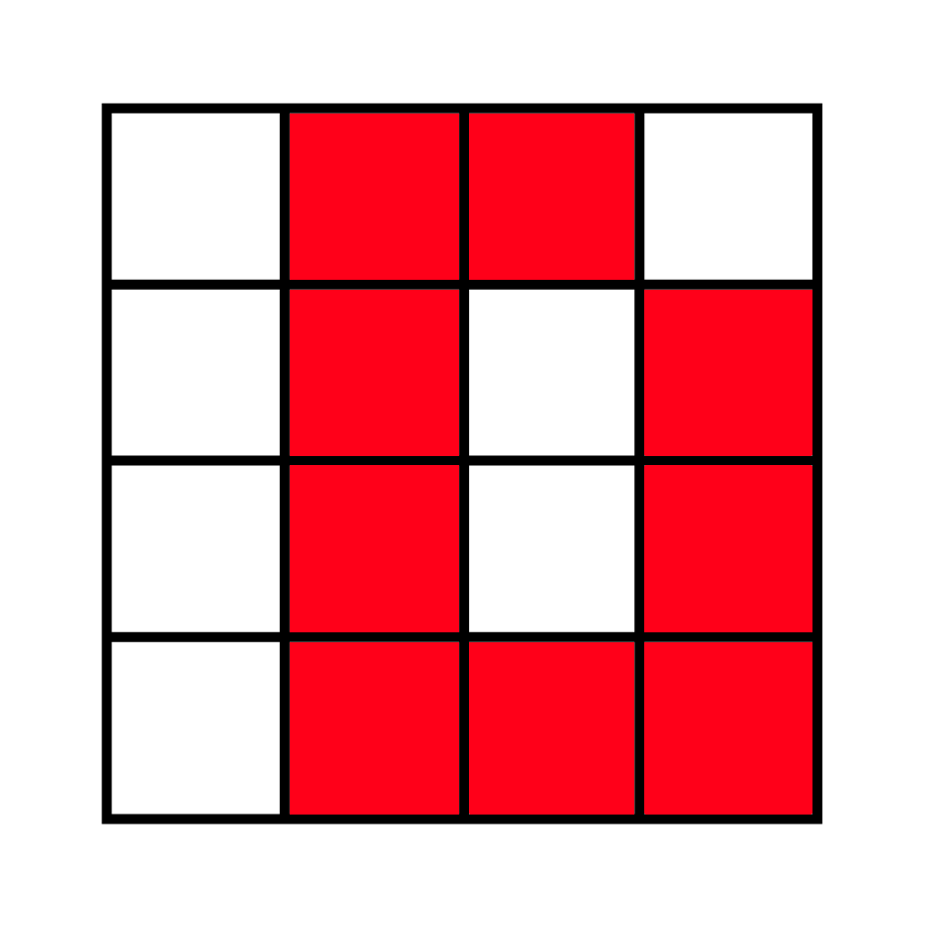

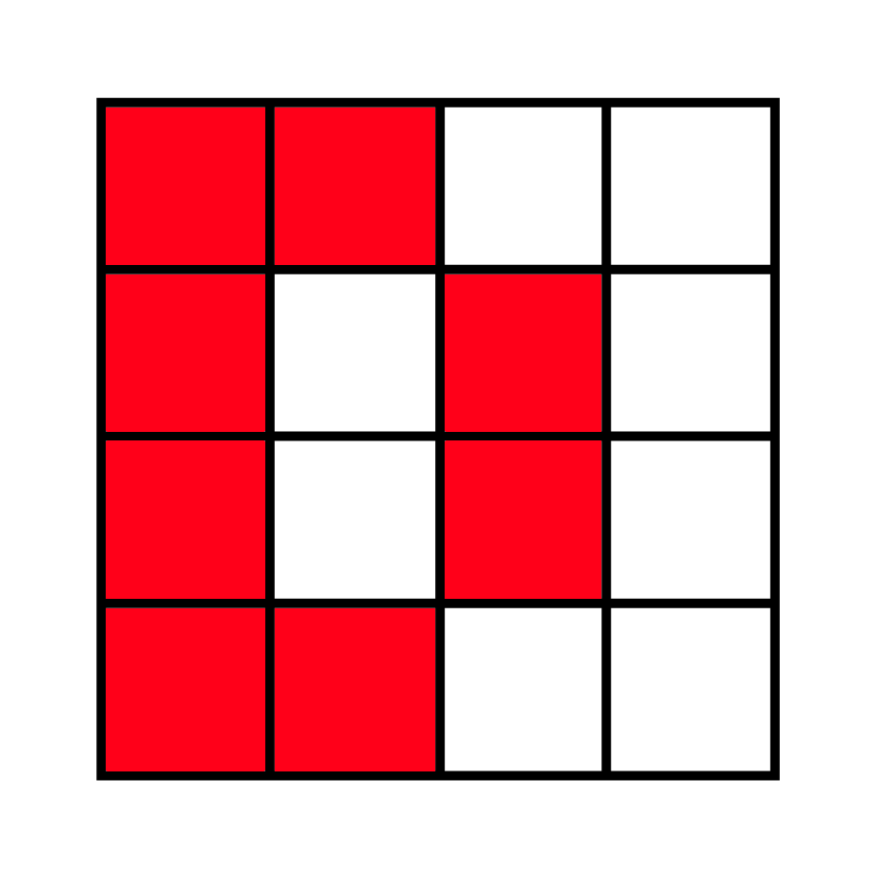
Symbols to an Average Image
Notes:
We need to create a representative image, aptly named the average image.
This is created by creating a whole bunch of images, and then averaging!

Slide 10










Average Images and Distance Transforms
Notes:
Here are the actual average images and average distance transforms created.
These allow us to measure how “good” a symbol is.
Talk more about what they are.

Slide 11
Distance Metrics for Binary Images
We need a way to compare two images!
Hausdorff Distance
Modified Hausdorff Distance
Tanimoto Coefficient
Yule Coefficient
Notes:
Motivate again. We want to see how far away another image is away.
Restrict for the moment to binary images.
A single distance metric is not enough.
[here or later ?]
Say that if one distance metric doesn’t work, it is the hope that the other ones will work.
Combined classifiers are never worse than the worst classifier, but it can be the case that the combined classifiers are better than even the best individual classifier.

Slide 12
Hausdorff Distance Example
A
B
1 | 1 | 1 | 1
0 | 0 | 0 | 0
0 | 0 | 0 | 0
0 | 0 | 0 | 0
1 | 1 | 1 | 1
1 | 0 | 0 | 0
1 | 0 | 0 | 0
1 | 1 | 1 | 1
h(A, B) = 0.0
h(B, A) = 3.0
H(A, B) = 3.0
Notes:
Directed distance from A to B intuitively means that every point in A is at most a distance h(A, B) away from some point in B.

Slide 13
Modified Hausdorff Distance Example
A
B
1 | 1 | 1 | 1
0 | 0 | 0 | 0
0 | 0 | 0 | 0
0 | 0 | 0 | 0
1 | 1 | 1 | 1
1 | 0 | 0 | 0
1 | 0 | 0 | 0
1 | 1 | 1 | 1
hmod(A, B) = 0.0
hmod(B, A) = 1.5
Hmod(A, B) = 1.5
Notes:
This is very similar to the previous measure, except instead of taking the maximum in the directed distance, the modified directed distance takes the average.
This helps against outliers (OUT LIE ARS) that the previous method did not take into account.

Slide 14


Tanimoto Example
A
B
1 | 1 | 1 | 1
0 | 0 | 0 | 0
0 | 0 | 0 | 0
0 | 0 | 0 | 0
1 | 1 | 1 | 1
1 | 0 | 0 | 0
1 | 0 | 0 | 0
1 | 1 | 1 | 1
α = 0.75 – 0.25 * 14 / 32 = 0.64
T(A, B) = 4 / (4 + 10 – 4) = 0.4
TC(A, B) = 6 / (4 + 10 – 2 * 4 + 6) = 0.5
TSC(A, B) = 0.64 * 0.4 + 0.36 * 0.5 = 0.44
Notes:
Tanimoto is a strict pixel matching similarity measure, no notion of distance except for overlapping.
The coefficient is a combination of how well the black pixels match (1) and how well the white pixels match(0).
Alpha determines the relative importance of black pixels vs white pixels.
An alpha of 1 says that only black pixels are important. An alpha of 0.5 says that black and white pixels are equally important.
It makes sense that we should weight our decision on the black pixels created.
Thus, alpha is a value between 0.5 and 0.75.

Slide 15
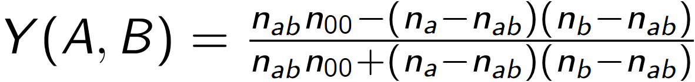
Yule Example
A
B
1 | 1 | 1 | 1
0 | 0 | 0 | 0
0 | 0 | 0 | 0
0 | 0 | 0 | 0
1 | 1 | 1 | 1
1 | 0 | 0 | 0
1 | 0 | 0 | 0
1 | 1 | 1 | 1
Y(A, B) = (4 * 6 – (4 – 4)(10 – 4)) / (4 * 6 + (4 – 4)(10 – 4)) = 1
Notes:
A similar pure pixel matching similarity measure, that uses the total number of overlapping black and white pixels to determine a measure. (na – nab) is the number of black pixels in A that where not matched in B.

Slide 16
Distance Metrics
We had to modify the binary image metrics slightly to get the desired effect with average images.
Notes:
But how do we find the distance between a binary image, and a non binary image?
We use slightly modified version of the distance metrics mentioned above.

Slide 17
Combining Distance Metrics
4 distance metrics against 5 definition images yields 20 properties (features) per sketched-symbol.
We put these 20 features into a Support Vector Machine.
Notes:
Instead of summing up the different distance measures, we give all of the information to an SVM.
Say that if one distance metric doesn’t work, it is the hope that the other ones will work.
Combined classifiers are never worse than the worst classifier, but it can be the case that the combined classifiers are better than even the best individual classifier.

Slide 18
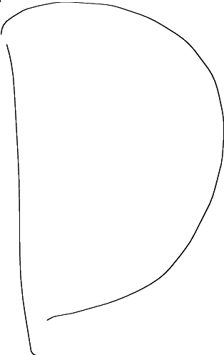
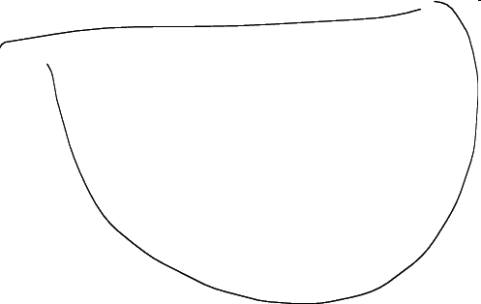
Distance Metrics
( , ) = (H1, M1, T1, Y1)
( , ) = (H2, M2, T2, Y2)
( , ) = (H3, M3, T3, Y3)
( , ) = (H4, M4, T4, Y4)
( , ) = (H5, M5, T5, Y5)
Notes:
Here is the image compared against all of the definition / average images, yielding 4 measures each, 20 features total.

Slide 19
Results
Top 1: 96%
Top 1 with Unknown: 93%
We want:
Symbol | And | Or | Not | Nor | Nand
Probability | 0.20 | 0.73 | 0.01 | 0.05 | 0.01
Fix me ☺
Notes:
Top 1: means that the classifier ranked highest (in terms of percentage) was the correct symbol.
Top 1 with Unknown: here, the classifier has the ability to say that it doesn’t know what the symbol is.

Slide 20
Current Limitations
Rotation does not perform well on non-similarly stroked symbols.
Unable to extract fine details about symbols.
Sensitive to non-uniform scaling.
Notes:
Non-uniform scaling is an advantage when trying to distinguish between rectangles and squares

Slide 21
Conclusion
Robust symbol recognition can be done without worrying about the number of strokes, the order of strokes, the orientation, or the size of the symbol.
Easily extendable to other domains.

Slide 23
Sketched-Symbol to Polar Image
We also create average polar images, and average polar distance transforms. This helps our sketched-symbol recognizer deal with rotated symbols, as we will see later.

Slide 24










Average Polar Images and Polar Distance Transforms

Slide 25
Rotating Sketched-Symbol to Match a Definition
Compute sketched-symbol’s polar image.
Translate the polar image along the theta axis to match each definition.
Rotate the initial sketched-symbol so that the orientation best matches that of the definition.

Slide 26




Illustrated Rotation
1. Compute Polar Image
3. Rotate Sketched-Symbol
2. Translate to match definition
 | Sketched-Symbol | Image | Polar Image | And Definition
Original
Rotated

Slide 28
Distance Transform
As we will see later, it is important that we can access a “minimum-distance-to-pixel” measure for every point (x, y) in an image. Thus, we need to create what is known as a distance transform.

Slide 29
Hausdorff Distance
Intuitively, every point in A is at most
a distance H(A, B) away from some point in B.
Notice that min||a – b|| is from the
distance transform that we computed earlier.

Slide 30
Modified Hausdorff Distance

Slide 31
Tanimoto Coefficient

Slide 32
Yule Coefficient

